Slide 1
Rasheed Strategic Plan 2017-2020

Slide 2
Strategy Development Framework
Rasheed Vision and Mission
workshop with Board members, staff and others to prioritize strategic directions
Rasheed Strategic Priorities
SP (1)
SP (2)
SP (3)
Strategic Goal 1.1
Strategic Goal 1.2
Strategic Goal 1.3
Strategic Goal 2.1
Strategic Goal 2.2
Strategic Goal 3.1
Strategic Goal 3.2
KPI’s and Targets
SMART Objective
SMART Objective
SMART Objective
SMART Objective
SMART Objective
SMART Objective
SMART Objective
Strategies / Initiatives
Strategy
Strategy
Strategy
Strategy
Strategy
Strategy
Strategy
Operational Plans “Actions”

Slide 3
Strategy Development – 1. Vision and Mission
Rasheed Vision
Jordan anchored with a national integrity system
Rasheed Mission
Strengthening pillars of good governance that are based on integrity, transparency, accountability, and rule of law through advocacy, monitoring, and social awarness

Slide 4
Strategy Development – 2. Strategic Priorities 2017-2020
Strategic Priorities
Rasheed identified four strategic priorities as its main areas of focus for the years 2017-2020:
Promote concepts and practices of integrity, transparency, accountability, anti-corruption and enforcement of good governance principles
Establishing and leading watchdog collation towards corruption
Public awareness about the principles of transparency and social accountability
Strengthening Rasheed Organizational Capabilities
Transparency and Integrity
Watchdog
Social Accountability
Internal Capabilities

Slide 5
Strategy Development – 2. Strategic Priorities 2017-2020
Impact Matrix
The impact matrix outlines the two main areas of change Transparency International is aiming to achieve:
Policy and institutional change - The ultimate aim is to ensure that intergovernmental institutions, governments, political parties and businesses have all the necessary mechanisms, policies or laws in place to redress and prevent corruption, sanction corrupt behavior, and promote good governance.
Behavior change - The ultimate aim is that individuals, communities, civil society organizations and social movements act systematically to promote global good governance and prevent corruption.

Slide 6
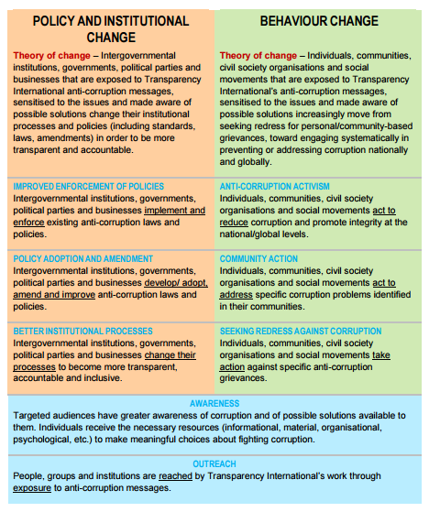
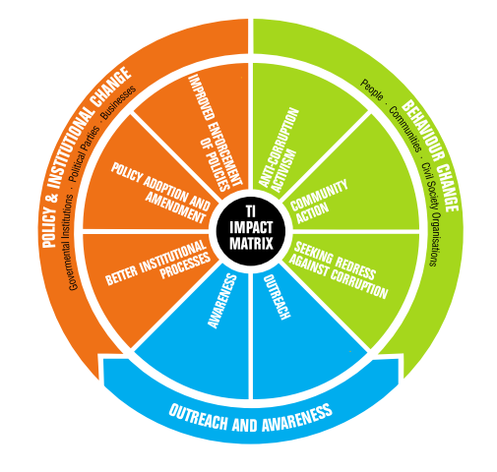
Strategy Development – 2. Strategic Priorities 2017-2020
Impact Matrix
Built on the Theory of Chnage, Rashed planned its interventions to achieve the following social impact and changes:

Slide 7
Strategy Development – 2. Strategic Priorities 2017-2020
Strategic Goals
Rasheed will be working on achieving the following strategic goals:
Promote concepts and practices of integrity, transparency, accountability, anti-corruption and enforcement of good governance principles
1.1 Contribution to empowering the Individuals, communities, civil society organizations and social movements act to reduce corruption and promote integrity at the national/global levels.
1.2 Contribution to encouraging Intergovernmental institutions, governments, political parties and businesses to implement and enforce existing anti-corruption laws and policies.
Establishing and leading watchdog collation towards corruption
2.1 Contribution to creating Individuals, communities, civil society organizations and social movements act to address specific corruption problems identified in their communities.
2.2 Contribution to taking actions by Individuals, communities, civil society organizations and social movements against specific anti-corruption grievances.
Public awareness about the principles of transparency and social accountability
3.1 Contribution to creating greater awareness among targeted audience of corruption and of possible solutions available to them. Individuals receive the necessary resources (informational, material, organizational, psychological, etc.) to make meaningful choices about fighting corruption
3.2 Contribution to conveying Transparency International’s work to People, groups and institutions through exposure to anti-corruption messages.
Strengthening Rasheed Organizational Capabilities
4.1 Strengthening Rasheed’s financial sustainability
4.2 Strengthening Rasheed’s internal capabilities
4.3 Enhancing Rasheed’s visibility and outreach activities
4.4 Preparing to become TI accredited full-fledged chapter and continuously improve internally to maintain the accreditation

